Slide 1


K.RAMAKRISHNAN COLLEGE OF ENGINEERING
(AUTONOMOUS)
EMBEDDED SYSTEMS AND IOT DESIGN
Intelligent Energy WITH REAL TIME MONITORING
TEAM MEMBERS :
NITHYA SHRREE S (8115u24ec072)
SAMEEHA FATHIMA S (8115U24EC093)
SUBASRRI D (8115U24EC110)
Guided by,
Dr. SAMSON DANIEL
Professor/ECE

Slide 2
INTRODUCTION
Tiered electricity tariffs cause steep bill increases when consumption crosses specific thresholds, yet standard meters offer no proactive warnings. Additionally, degrading appliances often draw continuous excess current that goes unnoticed by main circuit breakers, leading to hidden energy waste. To solve this, our proposed system integrates main-line metering with branch-level CT sensing, delivering real-time billing alerts at 80, 450, and 950 units along with instant, device-specific electrical fault diagnostics over IoT.

Slide 3
ABSTRACT
This project develops an ESP32-based Smart Energy Meter that combines total household billing with individual appliance fault detection over IoT. The system continuously tracks live power consumption and sends automated warning alerts at critical tariff milestones—80, 450, and 950 units—to prevent higher slab charges. Simultaneously, dedicated Current Transformer (CT) sensors monitor individual appliance lines to identify abnormal current spikes (such as motor or compressor faults) and report device-specific anomalies directly to a cloud dashboard.

Slide 4
LITERATURE REVIEW
PAPER | AUTHOR | TAKEAWAY/DRAWBACK | SOLUTION
IoT Based Smart Energy Meter Monitoring and Billing System (2020) | Manisha Tejwani, Prachi Rane, Moin Syed, Oyesh Patel, Pragya Pandey | Uses ATmega328P and ESP8266 for real-time pulse counting and ThingSpeak billing reports. It only tracks total mains consumption and lacks threshold warnings or appliance-level monitoring. | Adds multi-tier unit warnings (80, 450, 950 units) and branch-level CT sensors for device monitoring.
IoT Based Energy Meter Billing System (2018) | P. S. Vaidya, C. S. Kature, S. G. Waghmare, S. A. Dhumane | Uses Arduino and Wi-Fi to send automated billing updates and basic budget cap alerts via SMS/web. It uses static percentage caps instead of utility tariff slabs and lacks hardware to isolate individual appliance consumption. | Aligns alerts directly with realistic electricity slab jumps (80, 450, 950 units) and continuously tracks individual device power draw.
IoT based Energy Meter with Smart Monitoring of Home Appliances (2021) | Vishnukant V. Gavhane, Mayuri R. Kshirsagar, Ganesh M. Kale, Shubham Katangle | Combines main-line billing (ZMPT101B/ACS712) with remote relay switching for home appliances. Appliance tracking is limited to ON/OFF relay states rather than measuring live individual current consumption. | Uses dedicated Current Transformer (CT) sensors on individual lines to measure continuous live current and detect appliance degradation.

Slide 5
LITERATURE REVIEW
PAPER | AUTHOR | TAKEAWAY/DRAWBACK | SOLUTION
Design and Implementation of an Intelligent Smart Energy Meter Using IoT and Machine Learning (2024) | R. Sharma, A. Kumar, P. Verma, S. Singh | Integrates ESP32 with sensors and a Machine Learning model to detect power theft and total load anomalies. Anomaly detection is restricted to the main supply line and cannot identify which specific appliance is faulty. | Isolates component-level anomalies using branch CT sensors, pinpointing the exact malfunctioning device in real-time.
Smart Energy Meter Using IoT and Offline Data Storage (2022) | M. A. Patel, S. N. Joshi, V. K. Patel | Uses NodeMCU with ACS712 and ZMPT101B for RMS power calculation and grid over/under-voltage protection. Focuses strictly on main-line protection rather than appliance fault diagnosis or tariff slab alerts. | Extends current sensing to individual load branches and integrates dynamic multi-tier billing warnings.
IoT-Based Smart Energy Meter with Real-Time Fault and Anomaly Analytics (2023) | K. R. Suresh, B. Venkatesh, D. Anitha | Employs an ESP32 and cloud dashboard (Firebase/Blynk) for high-sampling RMS monitoring and global overload relay trips. Fault detection operates globally on the main line using fixed cut-offs instead of tiered slab alerts. | Combines sub-circuit CT fault diagnostics with a dynamic 3-tier slab alert algorithm (80, 450, and 950 units).

Slide 6
EXISTING SYSTEM
Standard Smart Energy Meter – Measures only the total household electricity consumption at the main supply line.
Monthly Billing System – Calculates electricity usage and generates the bill only at the end of the billing cycle.
Whole-House Monitoring – Treats all connected appliances as a single load, making individual appliance monitoring impossible.
No Fault Detection – Cannot identify abnormal current consumption or detect faulty appliances.
No Consumption Alerts – Does not notify users when electricity usage approaches higher tariff or billing limits.
Limited User Awareness – Users cannot remotely monitor energy usage or take timely action to reduce electricity consumption.

Slide 7
PROPOSED SYSTEM
Branch-Level Monitoring – Uses dedicated Current Transformer (CT) sensors to monitor the current consumption of individual appliances.
Real-Time Energy Monitoring – Measures voltage, current, power, and energy consumption continuously using a smart energy meter.
Dynamic Slab Warning System – Sends IoT alerts when energy consumption reaches 80, 180, and 280 units, warning users before the next 100-unit billing milestone.
Appliance Fault Detection – Detects abnormal current consumption to identify faulty or malfunctioning appliances.
Main-Line Smart Billing – Uses a PZEM-004T energy meter with an ESP32 to calculate power, energy usage, and estimated electricity bills in real time.
LCD Display – Displays live energy consumption and estimated electricity bill locally.
IoT Cloud Monitoring – Uploads energy usage, alert status, and appliance data to a cloud dashboard for remote monitoring via mobile or web.

Slide 8
COMPONENTS REQUIRED
Components | Specifications | Qty
Microcontroller | ESP32 / NodeMCU (ESP8266) | 1
Energy Meter | 230V Single-Phase Digital Meter | 1
Optocoupler | PC817 / MCT2E IC | 1
CT Sensor | SCT-013-000 Split-Core CT | 1
Driver Circuit | BC547 NPN Transistor / ULN2003 | 1
Relay | 5V DC Single-Channel Relay (10A/30A) | 1
LCD Display | 16x2 Character LCD + PCF8574 I2C | 1
Power Supply | (230V AC to 5V DC) | 1
AC Load | Incandescent Bulb / AC Motor | 1

Slide 9
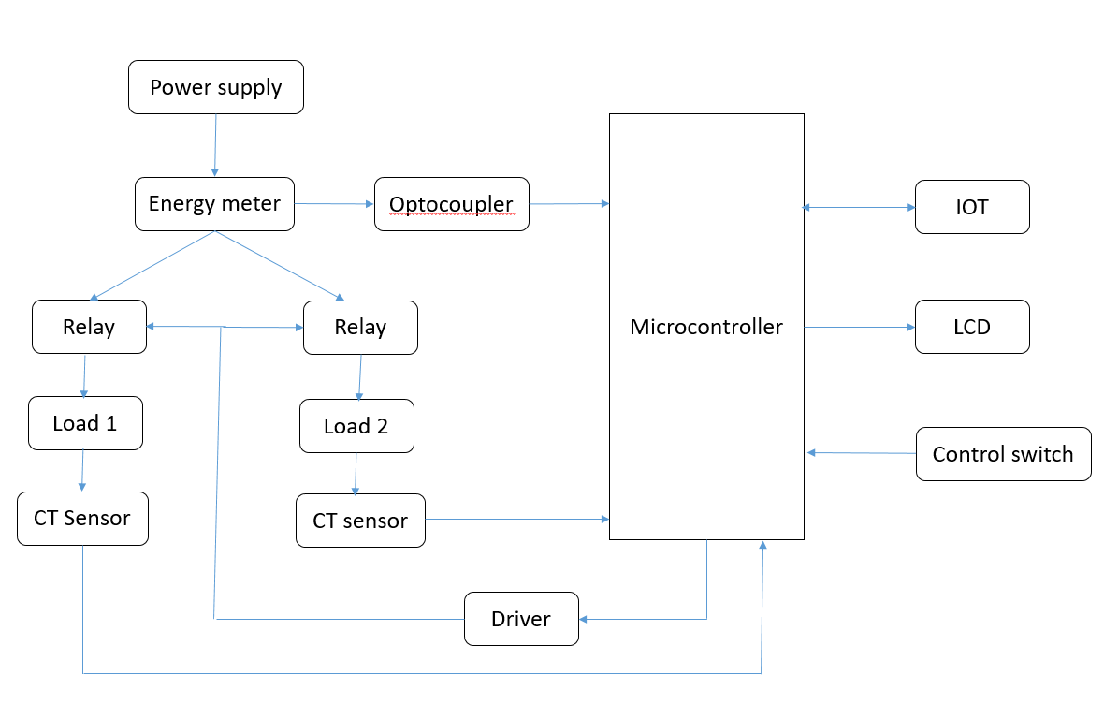
BLOCK DIAGRAM

Slide 10
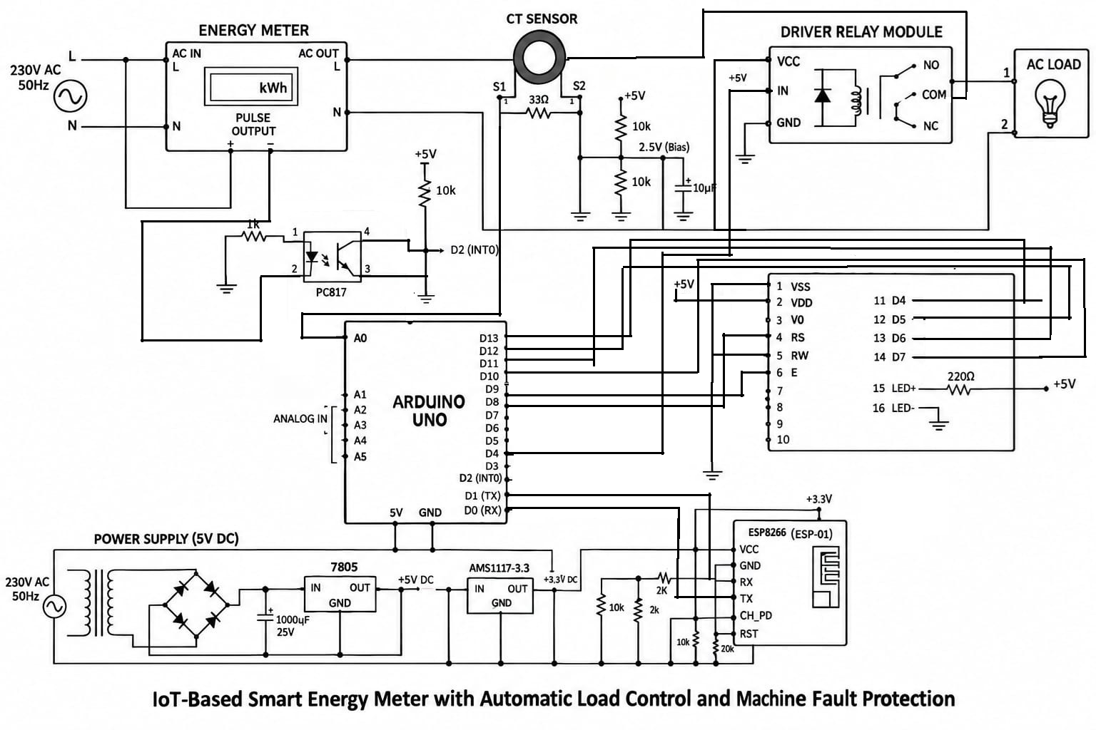
CIRCUIT DIAGRAM

Slide 11
CIRCUIT DIAGRAM EXPLANATION
Power Supply (5V DC): Steps down, rectifies, filters, and regulates 230V AC to a stable 5V DC via 7805 IC.
Energy Meter: Measures total power usage and sends calibration pulses to the Arduino.
CT Sensor: Clamped on the live line to measure real-time load current via analog pin A0.
Arduino Uno: Central controller calculating power, running safety logic, and managing modules.

Slide 12
CIRCUIT DIAGRAM EXPLANATION
Module: Safely switches the 230V AC load ON/OFF based on Arduino control signals.
16×2 LCD: Displays real-time voltage, current, and energy consumption metrics locally.
ESP8266 IoT Module: Transmits live power data to the cloud dashboard over Wi-Fi via UART.
AC Load: The output electrical appliance safely controlled by the relay.

Slide 13
ADVANTAGES
Proactive Tariff Warnings: Sends automated IoT alerts at critical billing milestones (80, 450, and 950 units) to prevent users from crossing into expensive higher tariff slabs.
Fault Detection: Uses dedicated CT sensors on individual branch lines to detect abnormal current spikes, instantly identifying degrading or faulty appliances.
Real-Time Remote Monitoring: Enables users to track live voltage, current, and overall energy consumption from anywhere using a cloud dashboard.
Automated Load Protection: Integrates relays that can automatically disconnect specific malfunctioning loads without shutting down the entire main power supply.

Slide 14
DISADVANTAGES
Internet Dependency: The system relies on a continuous Wi-Fi connection (via the ESP8266/ESP32 module) to update the cloud dashboard and send mobile alerts.
Initial Setup Complexity: Installing individual CT sensors and relays on every branch circuit requires invasive wiring and a more complex initial installation compared to standard single-point meters.
Hardware Cost: The inclusion of multiple sensors, optocouplers, microcontrollers, and IoT modules increases the initial hardware and deployment cost.
Continuous Power Requirement: The monitoring and alert system itself requires a continuous, stable 5V DC power supply to function and process data

Slide 15
Thank you

